Slide 1
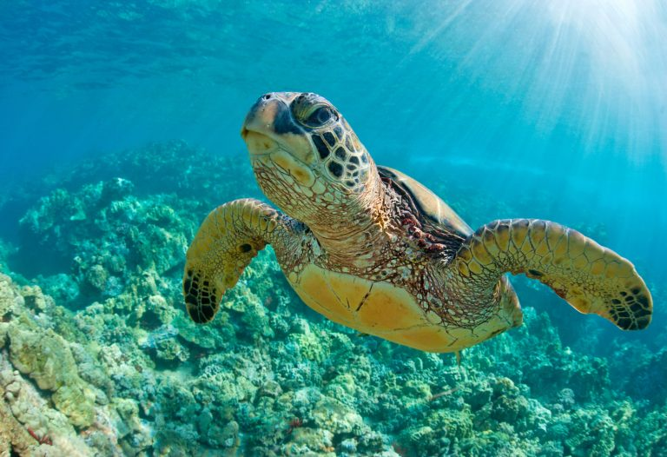
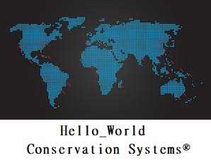
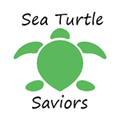
Seth Ayers: Author, Editor
Kurt Gallo: Artist, UX Engineer
Brian Snyder: Concepts, UX Engineer
Tim Seibert: Concepts, UX Engineer
Angelo Rivieccio: Concepts, UX Engineer

Slide 2
Mission Statement:
“Bring sea turtle conservation efforts to the digital age”

Slide 3
Hello_World Conservation System®
Bridging the gap between information technology and conservation efforts.
Provides a comprehensive means to organize, maintain and store sea turtle nesting site data.
Uses most modern mobile devices.
Allows conservationist to input vital nest information such as accurate nest location, approximant hatch times, species type, and threat level.

Slide 4
Hello_World Conservation System®
Users are all vetted through a process that verifies all conservation organizations
The centralized information can be accessed and parsed to better understand mating habit and weekly, monthly, and yearly trends of sea turtle migration.
Keeps information safe and secure; duel factor authentication and secure databases.

Slide 5
Start to Prototype:
Section 1: Contextual Inquiry and Analysis
Section 2: Requirements and Modeling
Section 3: Design
Section 4: Prototype

Slide 6

Section 1: Contextual Design

Slide 7
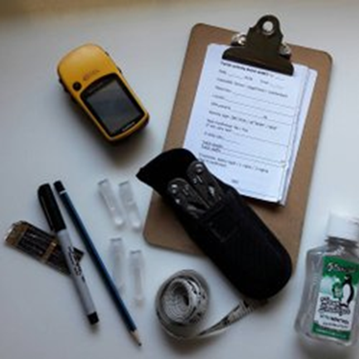
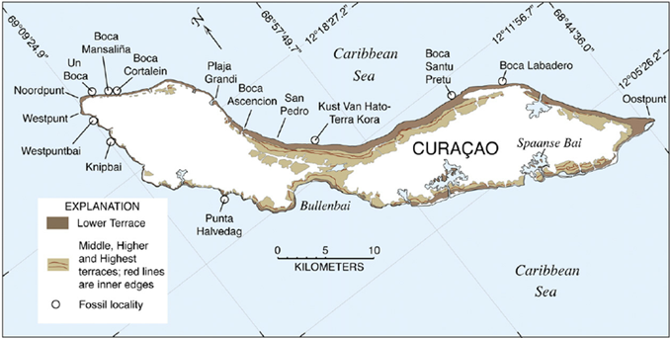
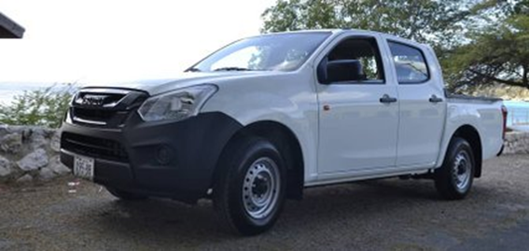
Work Artifacts

Slide 8
Email Questions
If an application were to exists that assist with your conservation efforts, what features would you like to see to make your job easier?
Are there organization issues do you experience in your conservation efforts? (Paperwork, managing information, managing volunteers, etc.)
What are the most difficult tasks of your job?
Do you have any criticisms or concerns in what is described in the project description above?

Slide 9
Email Response Samples
Yes to all of this! The paperwork is overwhelming sometimes. We treat over 500 sea turtles each year, and each turtle can have an enormous amount of paperwork, ie stranding report, treatment charts, x-rays, vet reports, lab tests, growth charts, etc. Also, we have about 100 volunteers for rehab, nesting patrols, and education.
A way to add descriptions to nests, a message system for volunteers, easy to use, who is looking over the nest
Unfortunately, researchers in our field don’t have an easy way to share data with each other that doesn’t involve multiple steps. When we do submit findings, it can take weeks or even a month to be fully disseminated to those who would use it.

Slide 10
Some responses were… Not so enthusiastic.
Getting a new system again will take up a lot of time again.... unless the majority start to use this, it does not have a lot of added value (sorry but a few bad experiences have made us pretty skeptical)

Slide 11
Work Activity Note Samples
Having an offline use of the app would be nice because mobile service is not always available
it’s vital that the data is stored in a secure place
a search function to filter the results
easy access to loaded data
It’s difficult and time consuming to fully get information out to the right groups
easy to use

Slide 12
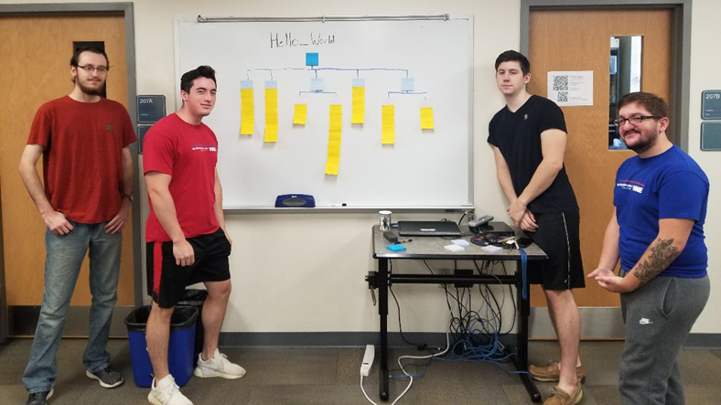
WAAD Construction

Slide 13
Section 2: Requirements and Modeling

Slide 14
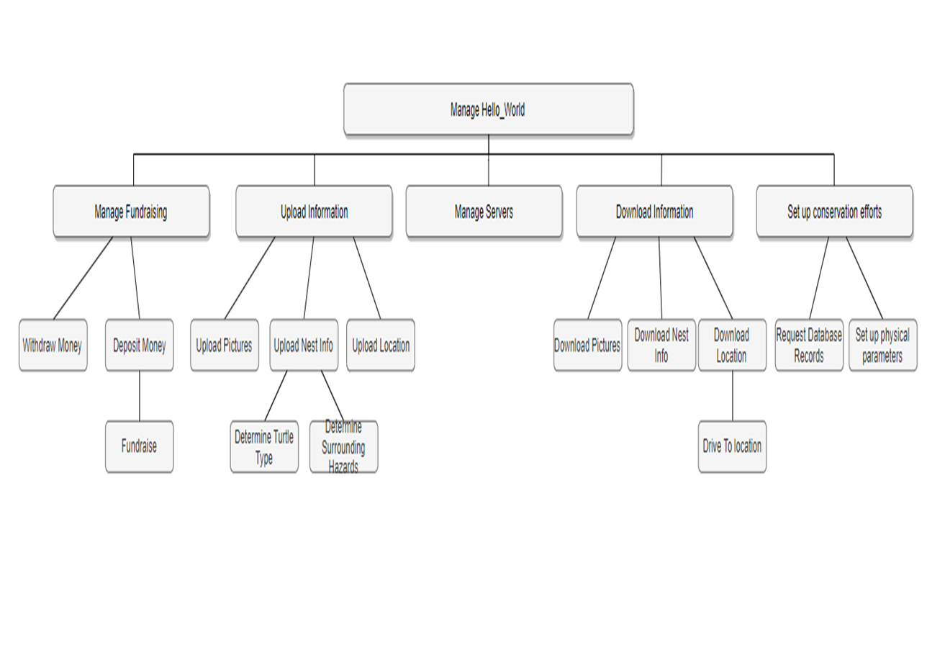
Hierarchical task model

Slide 15
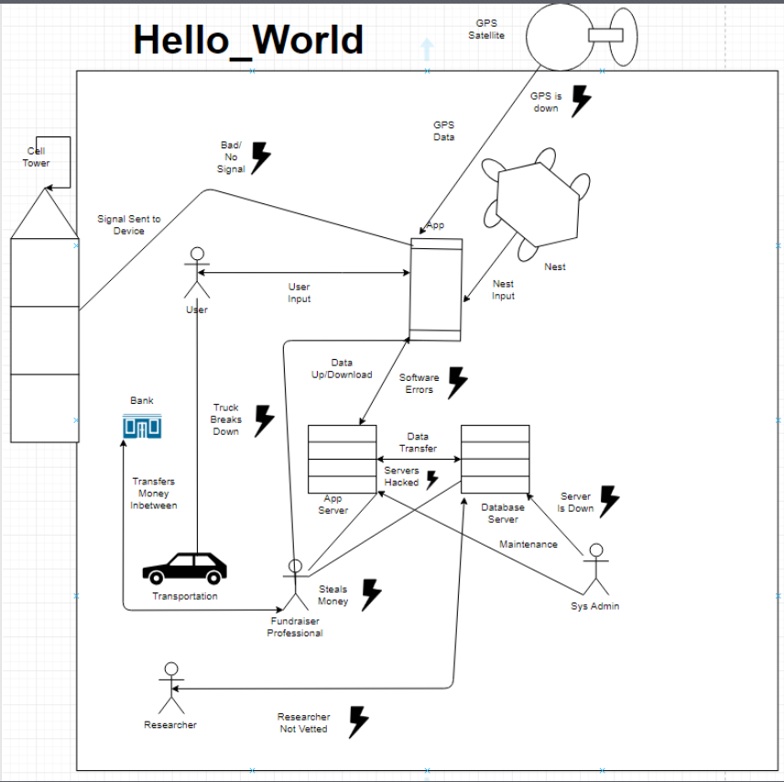
Work Flow Model and Barriers Samples
Poor or nonexistent 4G/3G cellular service may prevent from downloading or uploading information to the application.
Either Application server or database server may have downtimes or failures that would affect the performance of the application.

Slide 16
User Models
Field researcher/volunteer
Searches for nests, uploads information to database via the application.
Lab researcher
Downloads data from servers and uses information to assess sea turtle trends/possible threats.
System admins/database admins
Ensures all network functions are running properly, ensure security is maintained on the servers, and vets new organization requests to access server.
Software developer
Provides support through patches and fixes issues within the application code that is identified through bug reporting.

Slide 17
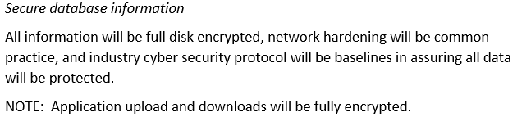
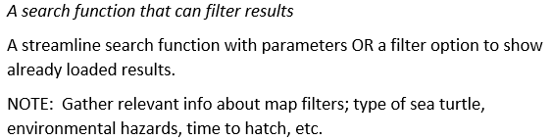
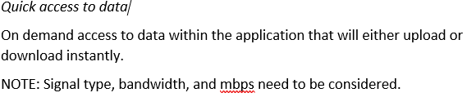
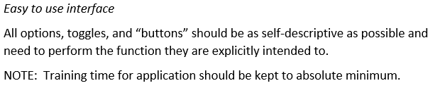
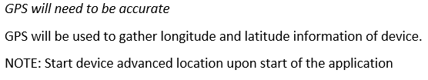
Requirement Extraction Samples

Slide 18
Section 3: Design

Slide 19
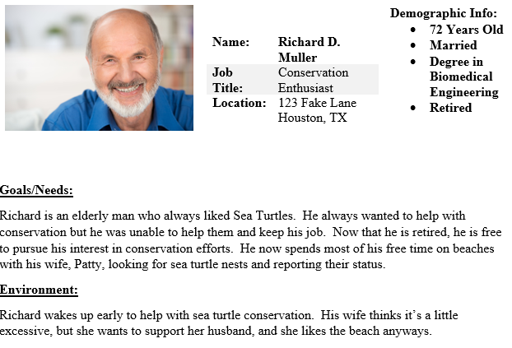
User Persona 1

Slide 20
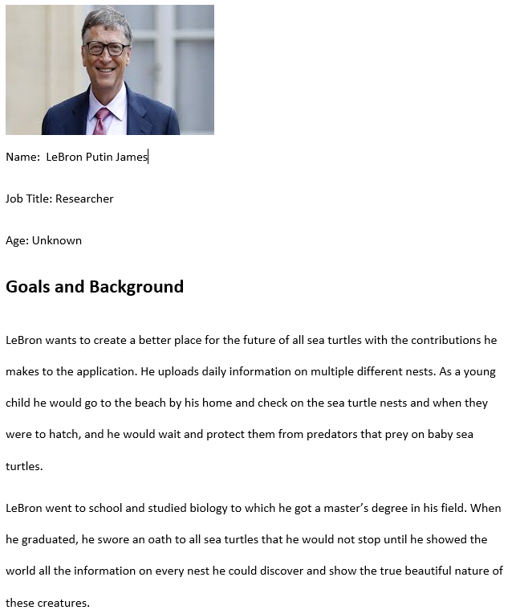
User Persona 2

Slide 21
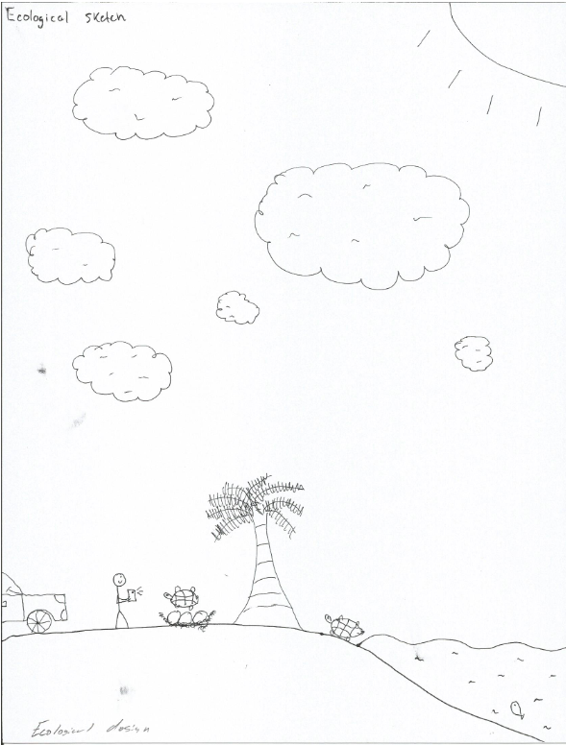
Ecological Design Sketch

Slide 22
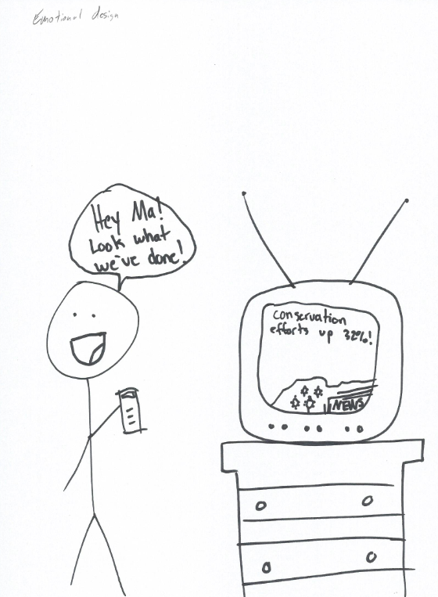
Emotional Design Sketch

Slide 23
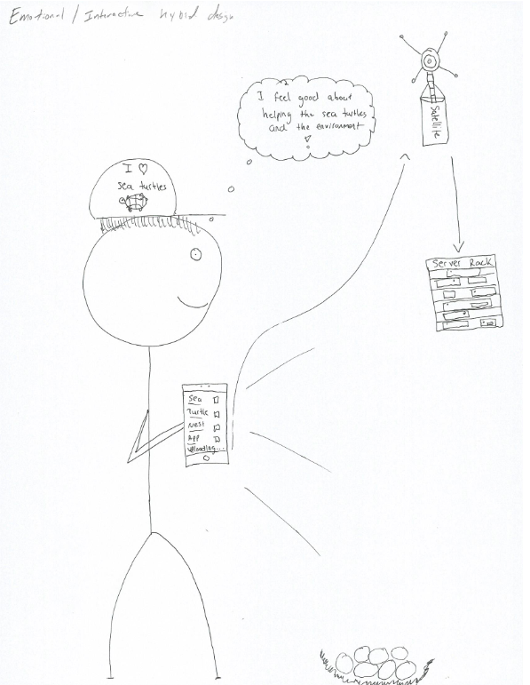
Emotional Interaction Hybrid Design Sketch

Slide 24
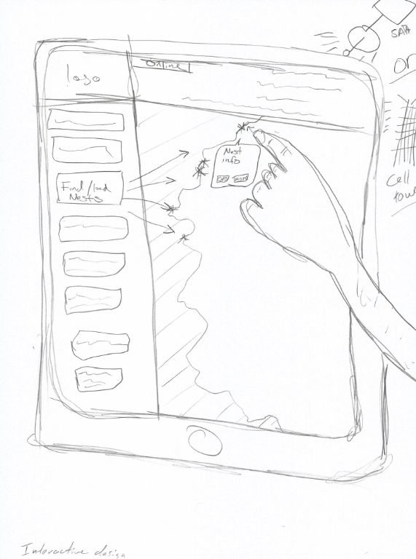
Interaction Design Sketch

Slide 25
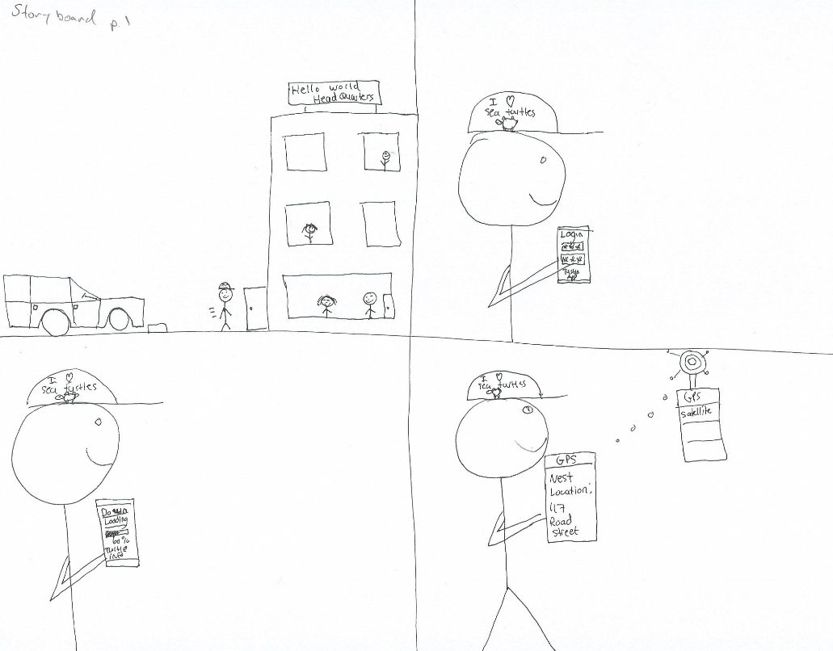
Storyboard Pt. 1

Slide 26
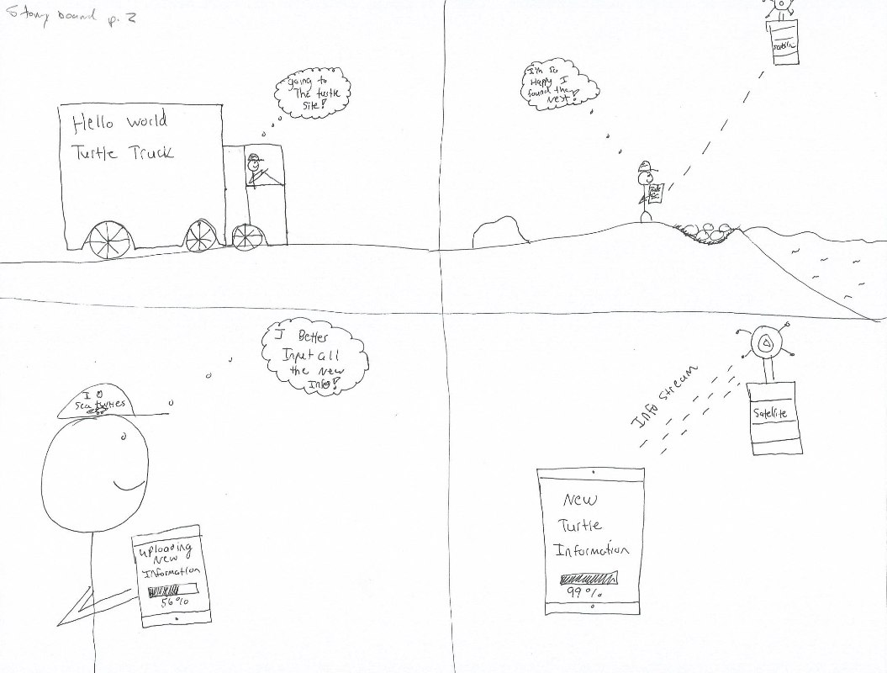
Storyboard Pt. 2

Slide 27
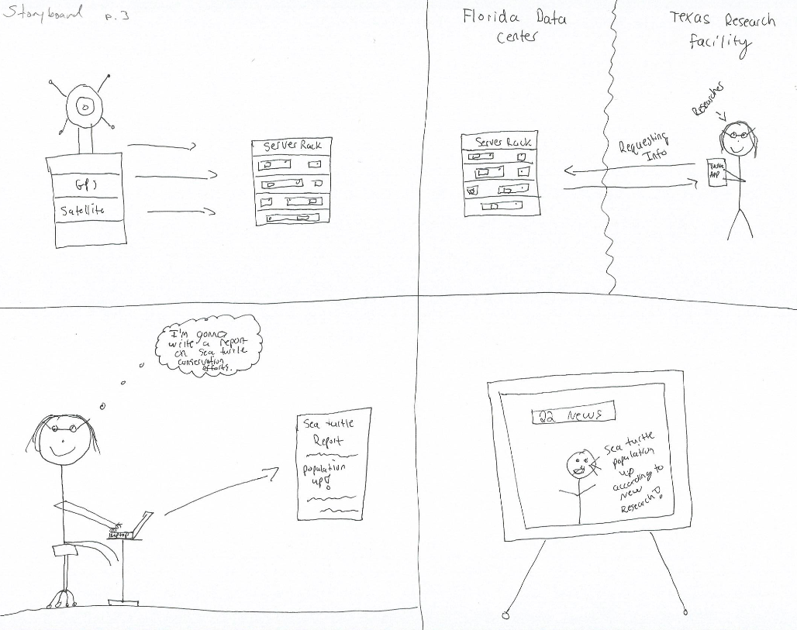
Storyboard Pt. 3

Slide 28
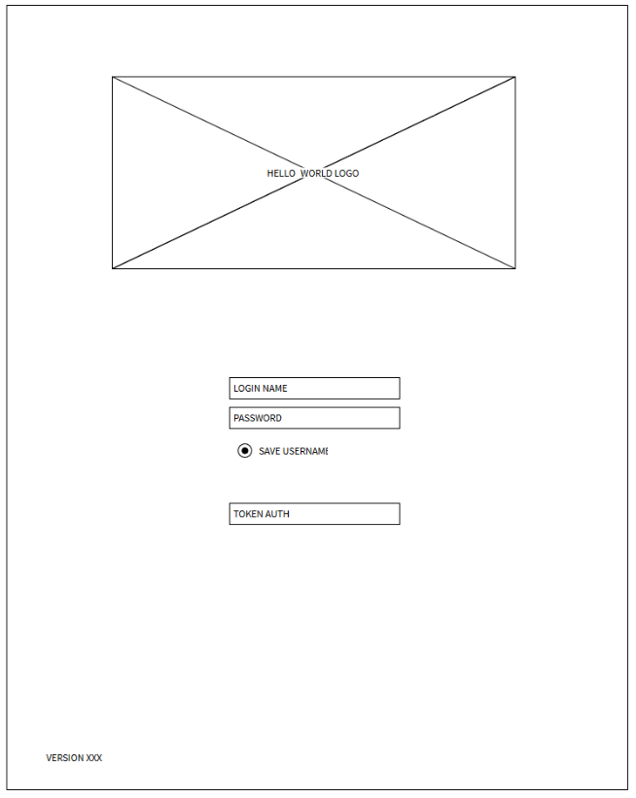
Wireframes

Slide 29
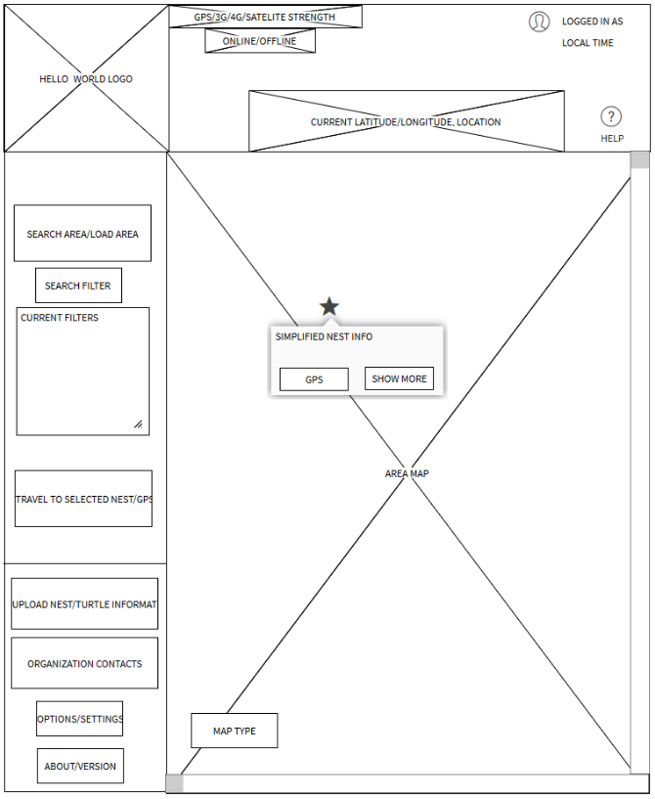
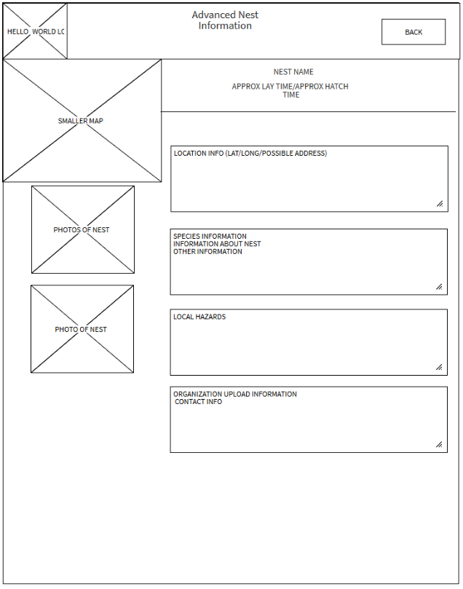

Slide 30
Section 4: Prototype

